Slide 1



Flight Delay Analysis
Project 1 - KU Data Analytics Bootcamp
Presented by:
Peiwen Chiu
Jen Zapata
Heidi Fox

Slide 2
01
Project Selection / Background
What
Why
How
CONTENTS
02
Analyzed
On-Time Performance
Delay Patterns
Airport and Airline Impact
03
On-Time Performance
04
Delay Patterns
05
Airport and Route Impacted

Slide 3
What – Why - How
This team chose to analyze flight delays over the past 5
years (May 2019 – May 2024). We narrowed our data to
include only four of the main domestic airlines: American,
Delta, United, and Southwest. We examine the delay
reason by using the five categories provided in the
dataset obtained by U.S. Bureau of Transportation
Statistics (BTS); carrier delay, weather delay, aviation
delay, security delay, or late aircraft.
This topic was selected because each of us on the team
travel frequently for work and pleasure. The idea of
digging into the data about delays intrigued us since we
have experienced the disruption of it often.
We collected the dataset from U.S. Bureau of
Transportation Statistics (BTS) as a csv file. The reason we chose this data is because it is a reliable source as well as having a robust amount of data for us to analyze. We
wrote and executed Python script in Jupyter Notebook to explore the data. We included Matplotlib and various
libraries for data visualization. Cleaned up the raw data in the csv file, renamed columns, removed all null values,
and created a new data frame for our calculations.
Flight delay categories:
Carrier Delay (carrier_ct): Delays caused by the airline itself, such as issues with crew, maintenance, or aircraft cleaning.
Weather Delay (weather_ct): Delays caused by weather conditions that make flying unsafe or impossible.
National Aviation System Delay (nas_ct): Delays related to air traffic control, airport operations, heavy traffic volume, or other reasons that
are part of the national aviation system.
Security Delay (security_ct): Delays caused by security-related issues such as security breaches or heightened security measures.
Late Aircraft Delay (late_aircraft_ct): Delays caused by a previous flight arriving late (can be combination of reasons), which impacts the
departure of the subsequent flight.

Slide 4




Top 3 Questions to Answer
On-Time Performance: What percentage of flights that are on time for each airline?
Comparison of Delay Causes and Number of Delayed Flights by Airline: How do the causes of delays and the number of delayed flights differ across each airline?
Airport and Airline Impact: Are delays linked to specific airports or hubs?
https://1000logos.net

Slide 5
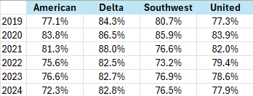
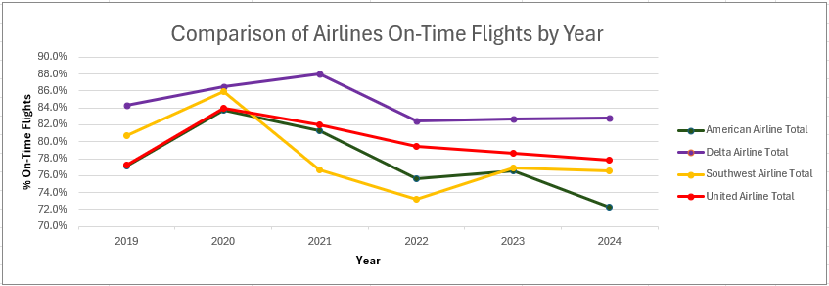
On-Time Flights
According to the International Air Transport Association (IATA), on-time performance (OTP) is a critical indicator of an airline's reliability and is typically defined as the percentage of flights that arrive and depart within 15 minutes of their scheduled time.
The data collected and analyzed for on-time flights showed an increased during 2020 and into 2021
This is the result of a reduction in flights during COVID. A reduction in flights will minimize airport traffic making it speedier to get through security as well as the boarding process at the gate. It will also reduce the amount of air traffic which allows for on-time flights.

Slide 6
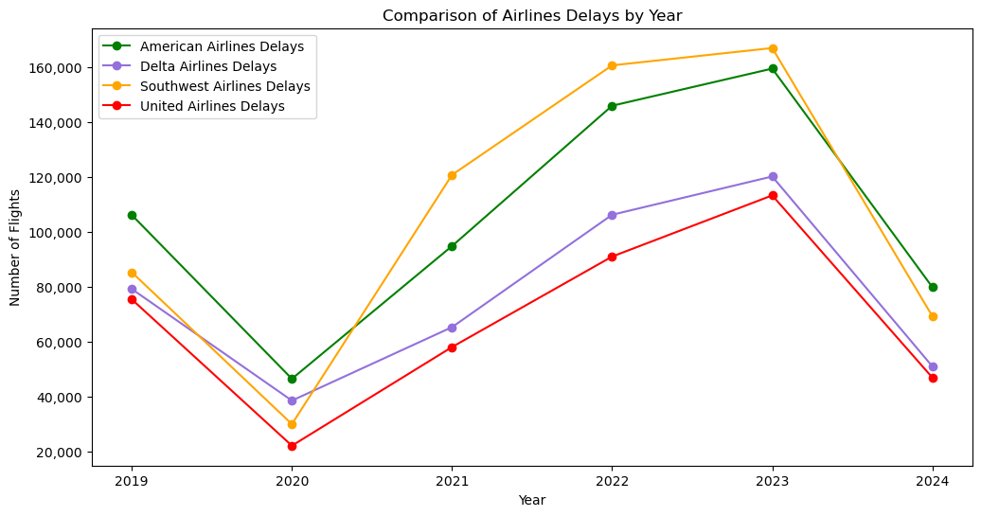
Delay Patterns
There is a noticeable dip in the number of delays across all airlines in 2020, likely due to the global impact of the COVID-19 pandemic, which significantly reduced flight operations. After 2020, a general upward trend is observed for all airlines, indicating a recovery in flight operations and possibly an increase in flight delays as air travel resumed to more typical levels. The number of delays appears to peak around 2022 or 2023.

Slide 7
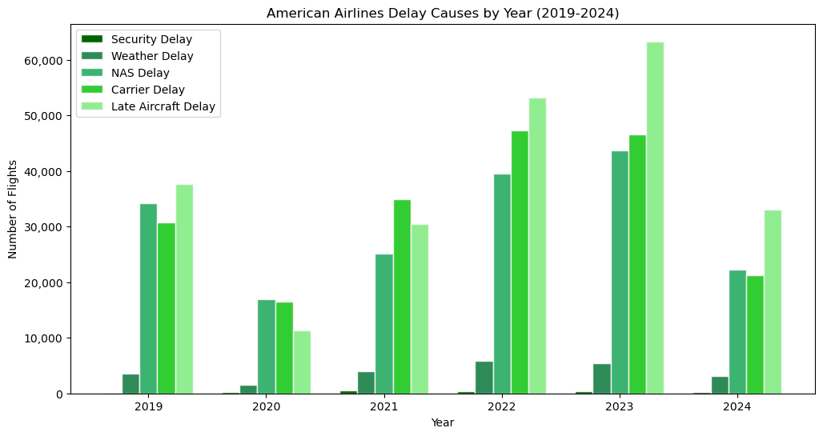
Delay Patterns

Slide 8
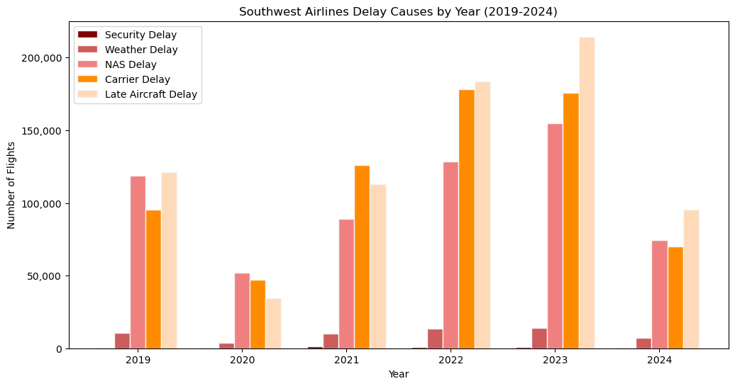
Delay Patterns

Slide 9
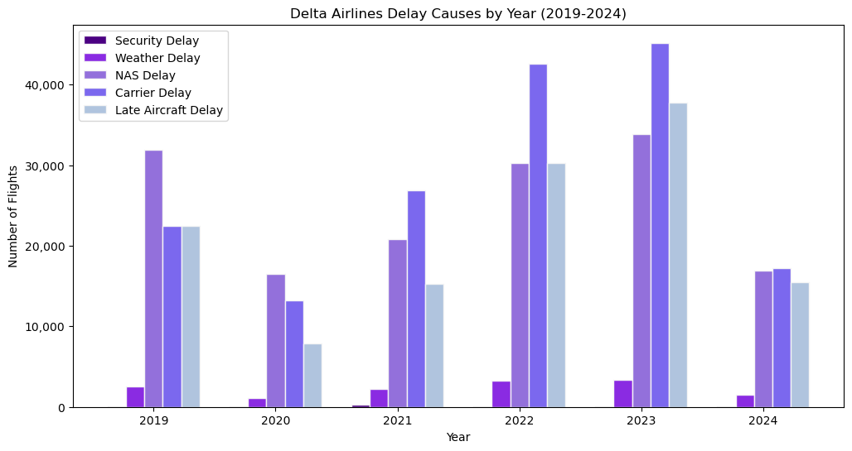
Delay Patterns

Slide 10
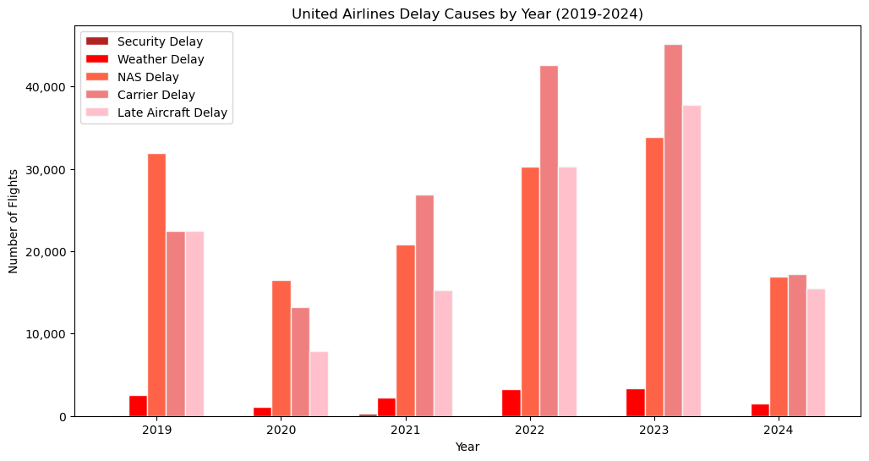
Delay Patterns

Slide 11
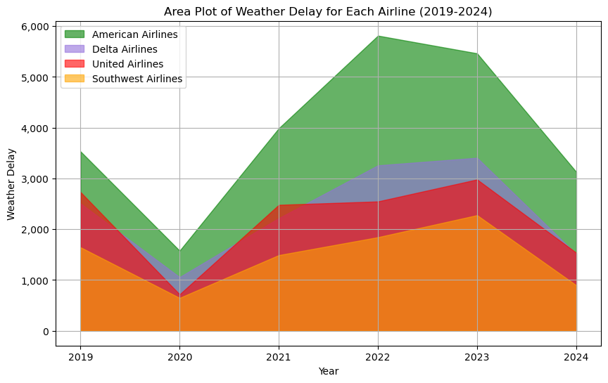
Delay Patterns

Slide 12
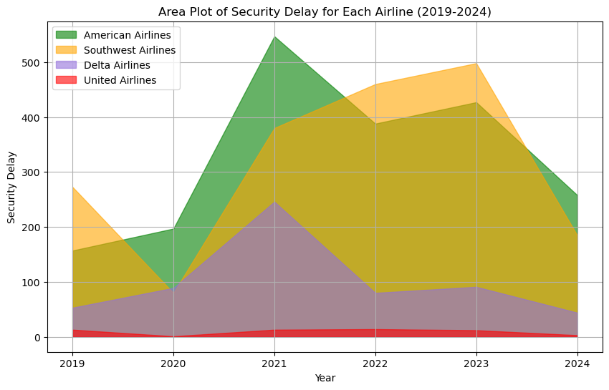
Delay Patterns

Slide 13
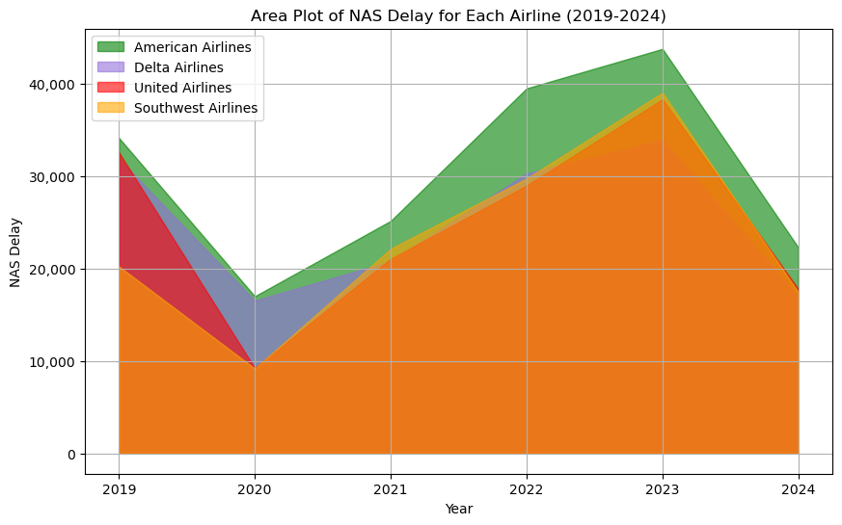
Delay Patterns

Slide 14
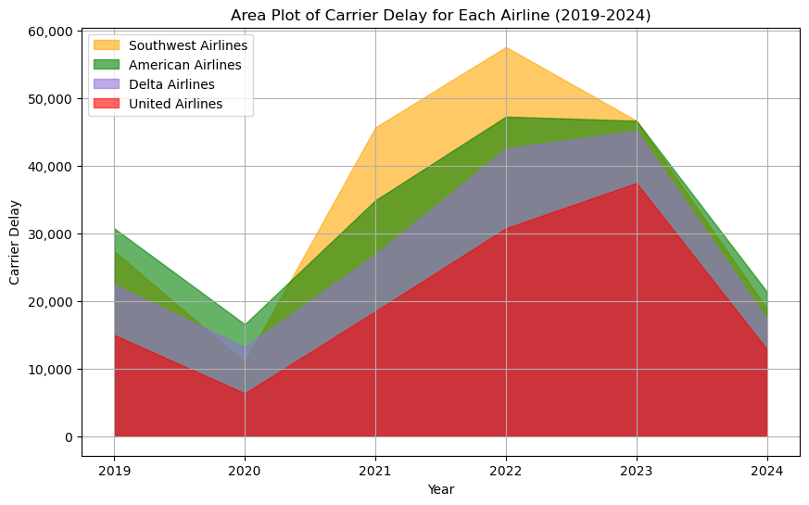
Delay Patterns

Slide 15
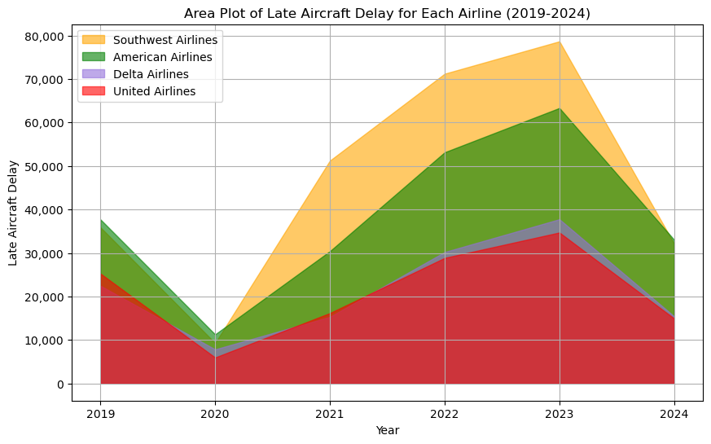
Delay Patterns

Slide 16
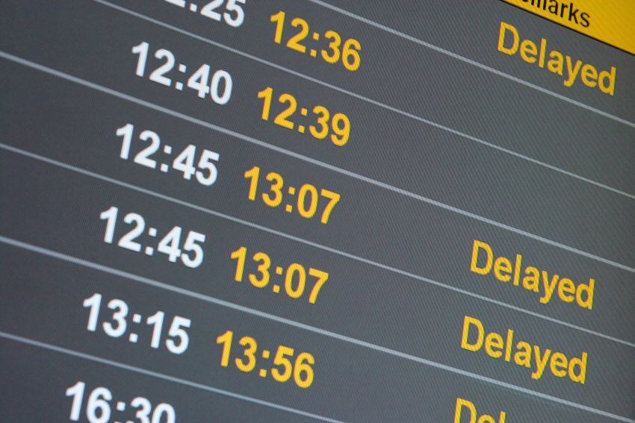
Delay Patterns - Conclusion
Southwest Airlines generally experiences higher delays across most categories, especially in carrier and late aircraft delays, which indicating significant operational challenges.
American Airlines shows a broad range of delays, especially in weather and security
categories, pointing to specific areas needing improvement in their operation procedures.
Delta Airlines and United Airlines generally perform better with lower delays across most categories, suggesting effective operations and management.
https://www.businesstravelnewseurope.com/Air-Travel/IATA-hits-out-at-US-airline-delay-compensation-plan

Slide 17

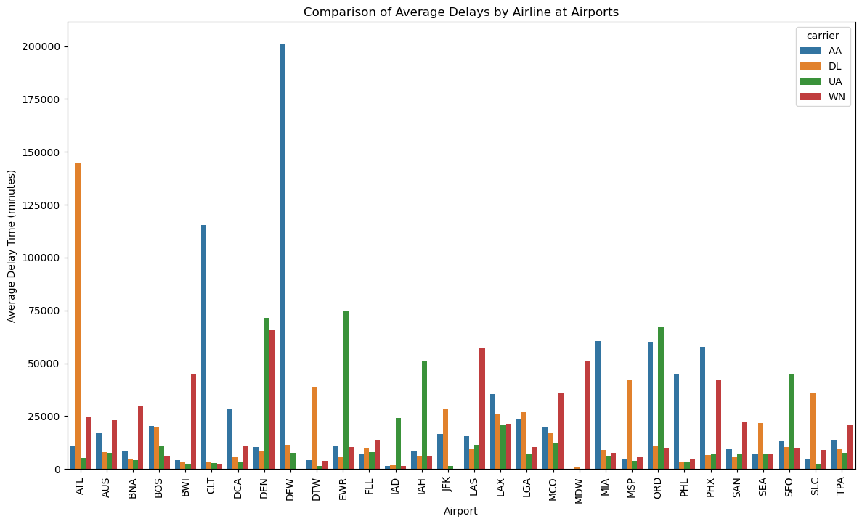
Airports & Airlines Impact
The graph highlights the variability in delay times across different airports and airlines, with major hub airports
showing more significant delays. It underscores the challenges faced by airlines operating in congested or
weather-prone airports and the potential need for
operational improvements.
Major hubs like ATL, ORD, and DFW handle a high volume of flights, leading
to congestion, which can cause delays.
United and American airlines have significant delays at (ORD) Chicago O’Hare
possibly due to congestion or weather-related issues.
United and Southwest also have the same problem at (DEN) Denver Airport
potentially due to weather challenges.

Slide 18
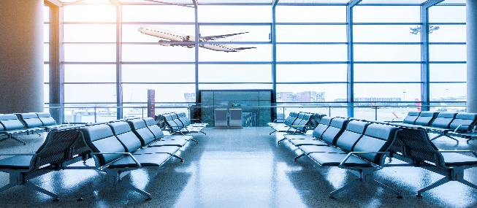
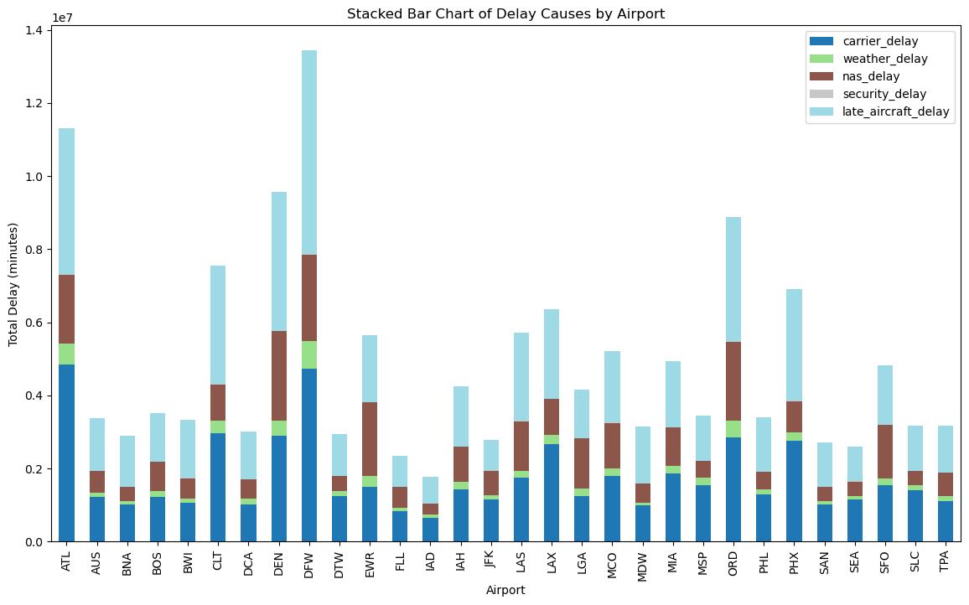
Airports & Airlines Impact and Summary
Airports like ATL, DFW, DEN, ORD, and PHX experience considerable late
aircraft delays, highlighting potential issues in flight scheduling and
turnaround times at these busy hubs.
Weather delays are prominent at airports like DFW and ORD, where
seasonal storms, severe weather patterns, and winter conditions are
common.
ATL and DFW stand out with major NAS delays, which can be linked to
their roles as major hubs with high volumes of connecting flights,
leading to air traffic control complexity and ground operations
congestion.
The chart highlights critical areas where delays are prevalent,
with DFW, ATL, and DEN facing the most significant challenges.
Addressing the root causes, such as airline operations, airspace
congestion, and weather preparedness, will be key to reducing
delays and improving overall flight efficiency across these major airports.

Slide 19
Do you have any questions?
THANK YOU!

